Slide 1
Database Technology
MySQL Programs
Stored Procedures, Functions, Cursors,Exceptions and Triggers
Shilpa Oswal
soswal@cdac.in

Slide 2
Stored Procedures in MySQL
A procedure (often called a stored procedure) is a subroutine like a subprogram in a regular computing language, stored in database. A procedure has a name, a parameter list, and SQL statement(s). All most all relational database system supports stored procedure
MySQL 5 introduce stored procedure
Benefits of Stored Procedure :
  Allow modular programming.
  Allow faster execution.
  Reduce network traffic.
  Can be used as a security mechanism.

Slide 3
Stored Procedures in MySQL
A stored procedure contains a sequence of SQL commands stored in the database catalog so that it can be invoked later by a program
Stored procedures are declared using the following syntax:
  Create Procedure <proc-name>
  (param_spec₁, param_spec₂, …, param_spec_{n} )
  begin
  -- execution code
  end;
  where each param_spec is of the form:
  [in | out | inout] <param_name> <param_type>
  in mode: allows you to pass values into the procedure,
  out mode: allows you to pass value back from procedure to the calling program

Slide 4
Stored Procedures in MySQL
CREATE PROCEDURE command creates the stored procedure.
- Next part is the procedure name.
Procedure names are not case sensitive.
Same database can not have two procedures with the same name.
You can use qualified names of the form "database-name.procedure-name", for example "hr.job_data".
Procedure names can be delimited. If the name is delimited, it can contain spaces.
The maximum name length is 64 characters.
Avoid using names of built-in MySQL functions.
The last part of "CREATE PROCEDURE" is a pair of parentheses. "()" holds the parameter(s) list , if there are no parameters in the procedure, the parameter list is empty.

Slide 5
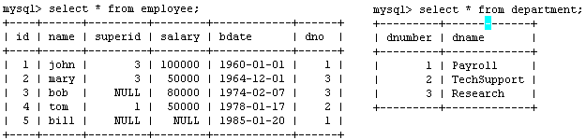
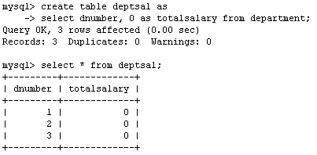
Example
Suppose we want to keep track of the total salaries of employees working for each department
We need to write a procedure to update the salaries in
the deptsal table

Slide 6
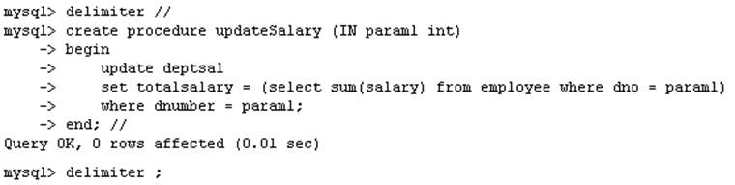
Example
Step 1: Change the delimiter (i.e., terminating character) of SQL statement from semicolon (;) to something else (e.g., //)
So that you can distinguish between the semicolon of the SQL statements in the procedure and the terminating character of the procedure definition

Slide 7
Example
Step 2:
Define a procedure called updateSalary which takes as input a department number.
The body of the procedure is an SQL command to update the totalsalary column of the deptsal table.
Terminate the procedure definition using the delimiter you had defined in step 1 (//)

Slide 8
Example
Step 3: Change the delimiter back to semicolon (;)

Slide 9
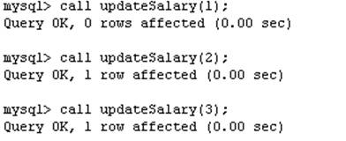
Example
Step 4: Call the procedure to update the totalsalary for each department

Slide 10
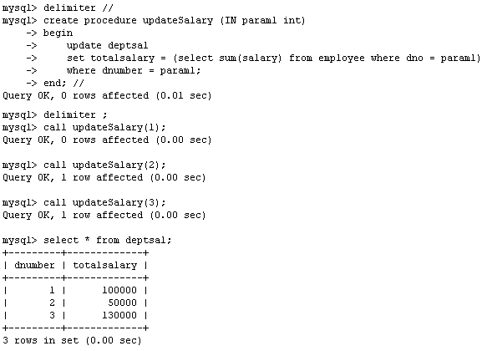
Example
Step 5: Show the updated total salary in the deptsal table

Slide 11
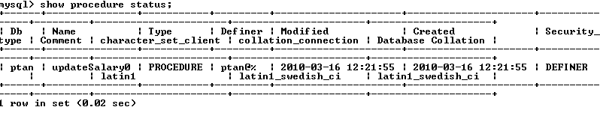

Stored Procedures in MySQL
Use show procedure status to display the list of stored procedures you have created
Use drop procedure to remove a stored procedure

Slide 12
MySQL : Procedure Parameters
1. CREATE PROCEDURE sp_name () ...
2. CREATE PROCEDURE sp_name ([IN] param_name type)...
3. CREATE PROCEDURE sp_name ([OUT] param_name type)...
4. CREATE PROCEDURE sp_name ([INOUT] param_name type)...

Slide 13
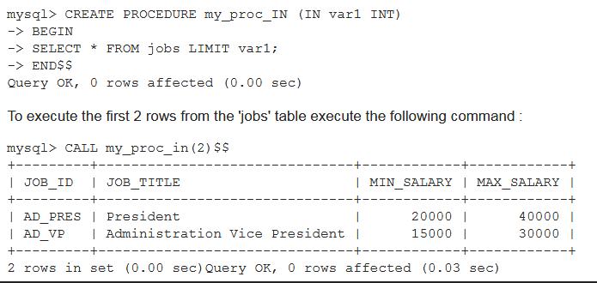
MySQL Procedure : Parameter IN example
In the following procedure, we have used a IN parameter 'var1' (type integer) which accept a number from the user. Within the body of the procedure, there is a SELECT statement which fetches rows from 'jobs' table and the number of rows will be supplied by the user. Here is the procedure :

Slide 14
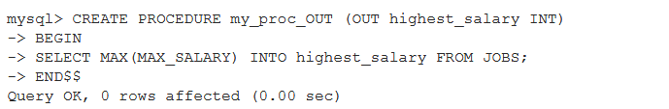
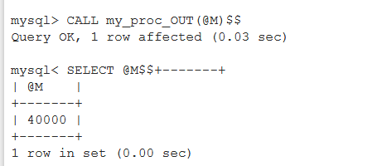
MySQL Procedure : Parameter OUT example
The following example shows a simple stored procedure that uses an OUT parameter. Within the procedure MySQL MAX() function retrieves maximum salary from MAX_SALARY of jobs table

Slide 15

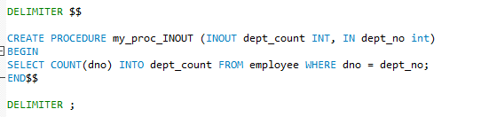
MySQL Procedure : Parameter INOUT example

Slide 16
Stored Procedures in MySQL
You can declare variables in stored procedures
You can use flow control statements (conditional IF-THEN-ELSE or loops such as WHILE and REPEAT)
MySQL also supports cursors in stored procedures.
  A cursor is used to iterate through a set of rows returned by a query so that we can process each individual row.
To learn more about stored procedures, go to:
  http://www.mysqltutorial.org/mysql-stored-procedure-tutorial.aspx

Slide 17
MySQL : Flow Control Statements
MySQL supports following constructs for flow control within stored programs. It also supports RETURN within stored functions.
IF
CASE
ITERATE
LEAVE
LOOP
WHILE
REPEAT

Slide 18
If and CASE Statement
The IF statement implements a basic conditional construct within a stored programs and must be terminated with a semicolon.
. Here is the syntax of if and Case statement :
IF condition THEN statement(s) [ELSEIF condition THEN statement(s)] ... [ELSE statement(s)] END IF
CASE WHEN search_condition THEN statement_list [WHEN search_condition THEN statement_list] ... [ELSE statement_list] END CASE

Slide 19
MySQL Loops
MySQL provides loop statements that allow you to execute a block of SQL cod repeatedly based on a condition.
There are three loop statements in MySQL:
WHILE,
REPEAT
LOOP.

Slide 20
MySQL : WHILE Statement
The WHILE statement executes the statement(s) as long as the condition is true. The condition is checked every time at the beginning of the loop. Each statement is terminated by a semicolon (;).
Here is the syntax:
    [begin_label:
    WHILE search_condition DO
    statement_list ;
    END WHILE [end_label]

Slide 21
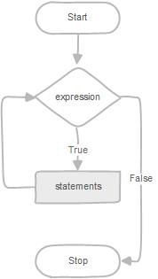
While LOOP
 | WHILE expression DO statements END WHILE
The following flowchart illustrates the WHILE loop statement:

Slide 22
MySQL: Loop constructs
MySQL: ITERATE Statement
ITERATE means "start the loop again". ITERATE can appear only within LOOP, REPEAT, and WHILE statements. Here is the syntax :
ITERATE label
MySQL: LEAVE Statement
LEAVE statement is used to exit the flow control construct that has the given label. If the label is for the outermost stored program block, LEAVE exits the program. LEAVE can be used within BEGIN ... END or loop constructs (LOOP, REPEAT, WHILE). Here is the syntax :
LEAVE label
MySQL:LOOP Statement
LOOP is used to create repeated execution of the statement list. Here is the syntax : [begin_label:]
LOOP statement_list
END LOOP [end_label]

Slide 23
MySQL: REPEAT Statement
The REPEAT statement executes the statement(s) repeatedly as long as the condition is true. The condition is checked every time at the end of the statements.
    [begin_label:]
    REPEAT statement_list
    UNTIL search_condition
    END REPEAT [end_label]
statement_list: List of one or more statements, each statement terminated by a semicolon(;).
search_condition : An expression.
A REPEAT statement can be labeled.

Slide 24
MySql Functions
Functions are declared using the following syntax:
  function <function-name> (param_spec₁, …, param_spec_{k})
  returns <return_type>
  [not] deterministic if same output for the same input (use RAND not deterministic )
  Begin
  -- execution code
  end;
  where param_spec is:
  [in ] param_name> <param_type>
  You need ADMIN privilege to create functions on mysql-user server

Slide 25
MySQL: RETURN Statement
The RETURN statement terminates execution of a stored function and returns the value expr to the function caller. There must be at least one RETURN statement in a stored function. There may be more than one if the function has multiple exit points. Here is the syntax :
  RETURN expr
  This statement is not used in stored procedures or triggers. The LEAVE statement can be used to exit a stored program of those types.

Slide 26
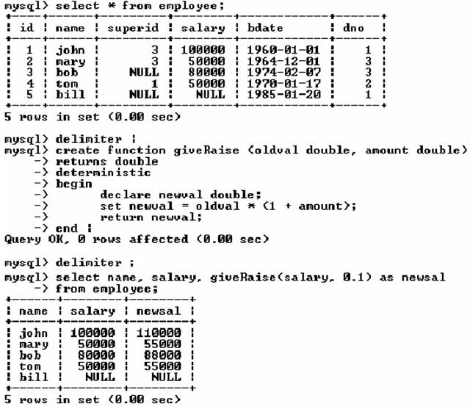
Example of Functions

Slide 27
Example of Functions

Slide 28
SP Vs Function
Stored Procedure | Functions
PROCEDURE may return one or more values through parameters or may not return any at all. | A FUNCTION always returns a value using the return statement.
Functions are normally used for computations | Procedures are normally used for executing business logic.
Procedure can return multiple values (max 1024). | A Function returns 1 value only.
procedures cannot be called directly by SQL statement | A function can be called directly by SQL statement
Can have IN/OUT/INOUT parameters | Can have only IN parameters

Slide 29
MySql Cursors
A database cursor is a control structure that enables traversal over the records in a database.
Cursors are used by database programmers to process individual rows returned by database system queries. Cursors enable manipulation of whole result sets at once
MySQL supports cursors inside stored programs. Cursors have these properties
  Asensitive: The server may or may not make a copy of its result table
  Read only: Not updatable
  Nonscrollable: Can be traversed only in one direction and cannot skip rows

Slide 30
Example without Cursor
Step 3: Change the delimiter back to semicolon (;)

Slide 31
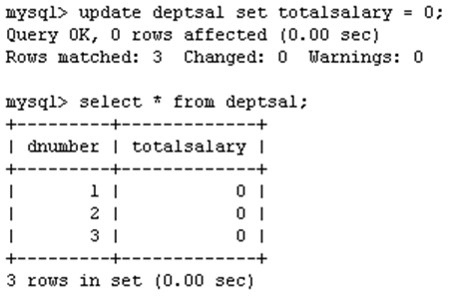
Example using Cursors
The previous procedure updates one row in deptsal table based on input parameter
Suppose we want to update all the rows in deptsal simultaneously
  First, let’s reset the totalsalary in deptsal to zero

Slide 32
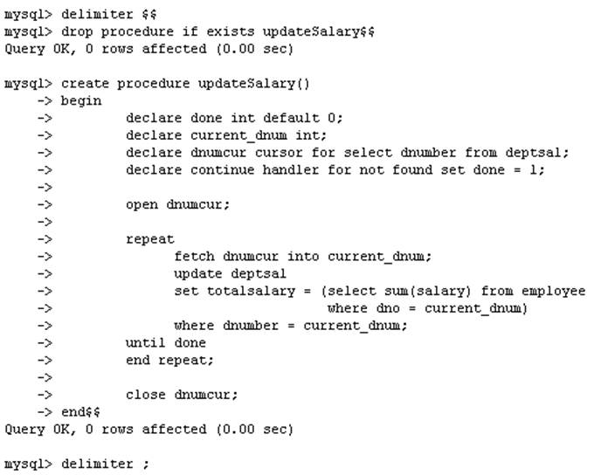
Example using Cursors
Drop the old procedure
Use cursor to iterate the rows

Slide 33
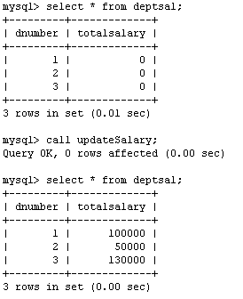
Example using Cursors
Call procedure

Slide 34
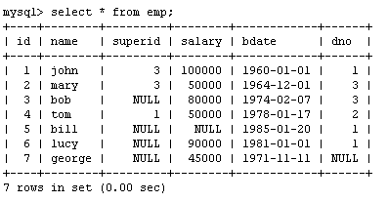
Example using Cursors
Create a procedure to give a raise to all employees

